Slide 1

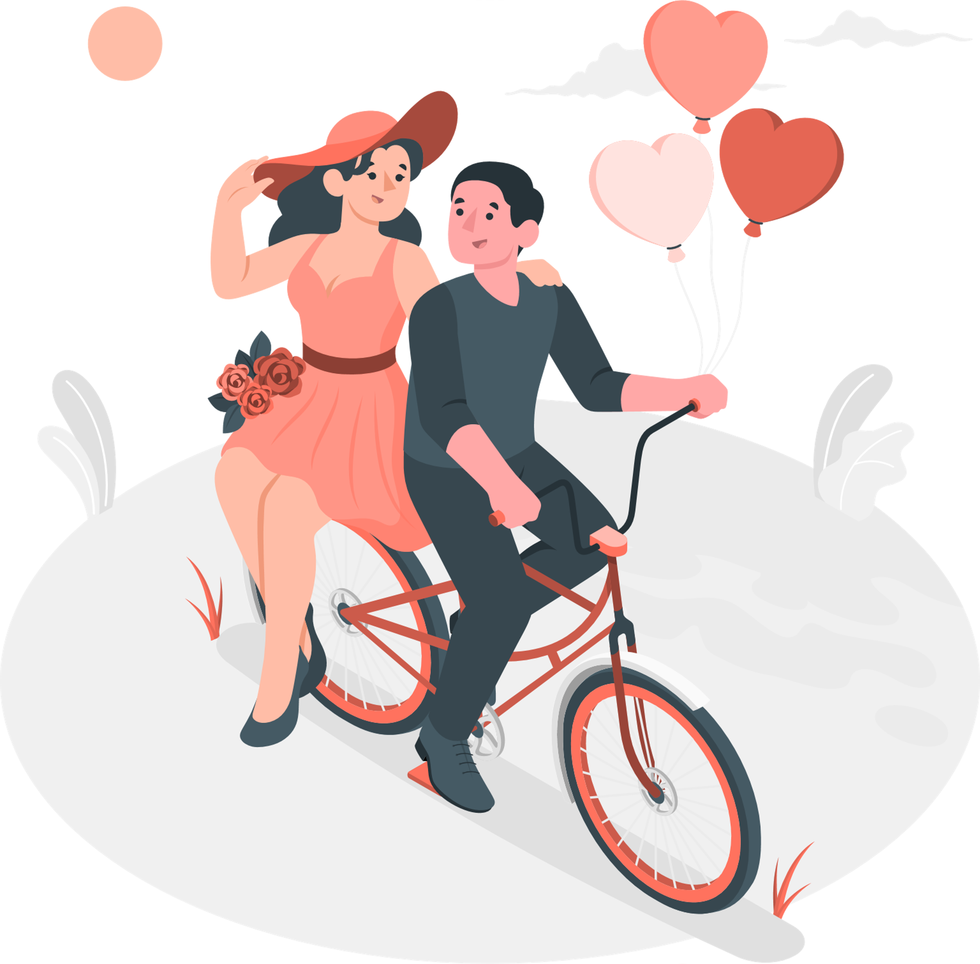
Topic :
Happy Birthday Wishes for a Crush

Slide 2
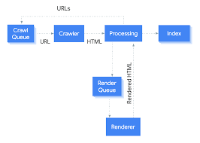
Google does ranking on based on the process of "INDEXING" and this is done by google crawler the more the crawler gets our website the more Index we will receive and thus Ranking Increases.
And all of this is based on these facts.

Slide 3

1. E-A-T
E-A-T, which stands for Expertise, Authoritativeness, and Trustworthiness, is the framework that Google raters use to assess content creators, webpages, and websites as a whole.

Slide 4
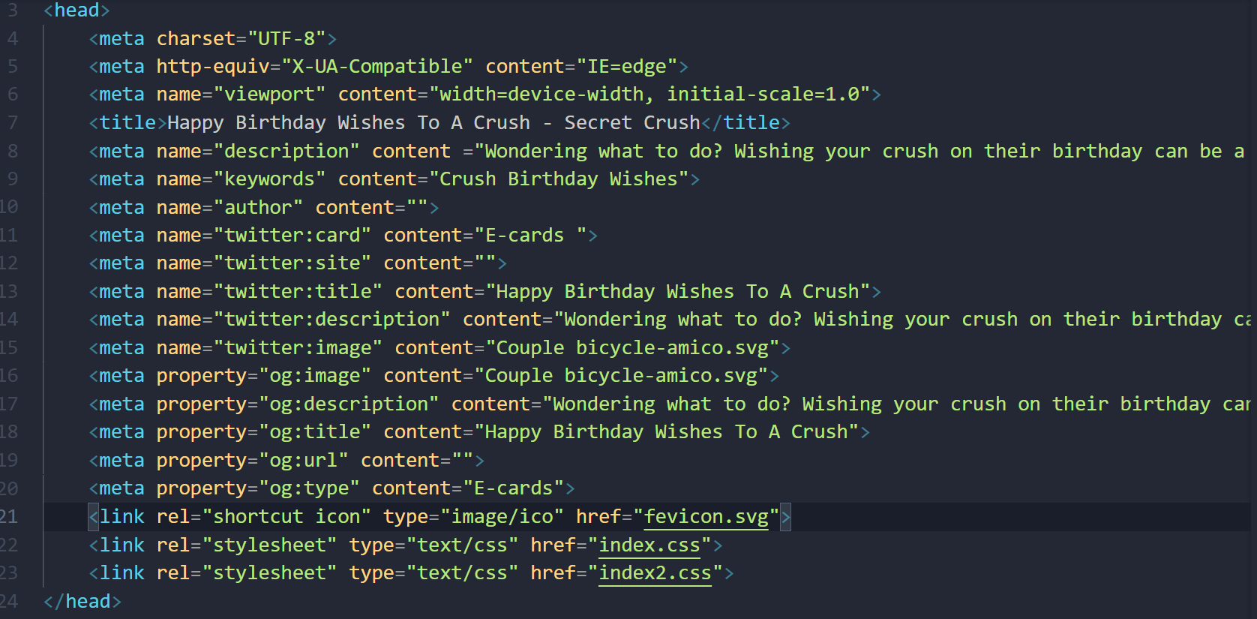
Meta Description
Twitter tag: like feature snippet
Og tag open graph
Title

Slide 5
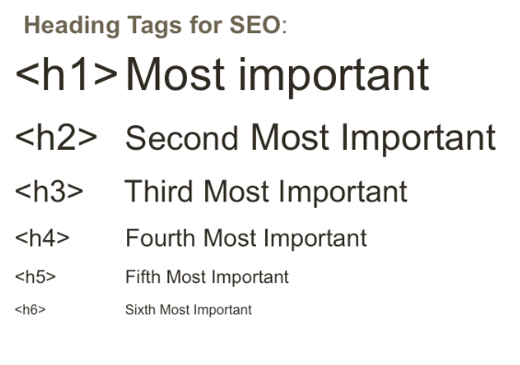
OTHER FACTORS :
Headlines
Header Tags
Keyword Cannibalization
Use article tag
Loading speed like

Slide 6

7. SEO Writing
To write the content for bot(Bot friendly) and also for the human.

Slide 7
itemscope itmetype="https://schema.org/image"
itmeprop="image"
id="svg"
alt="Happy Birthday Wishes To A Crush - Couple on bicycle - Celebrare">
Reduce the size
Use of alt tag
8. Image Optimization

Slide 8

10. User Engagement

Slide 9
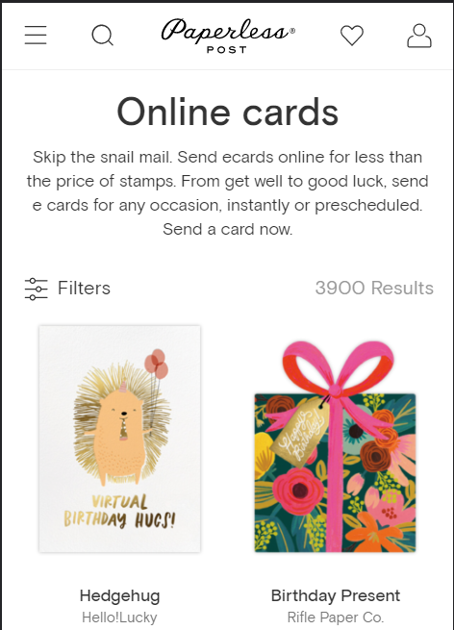
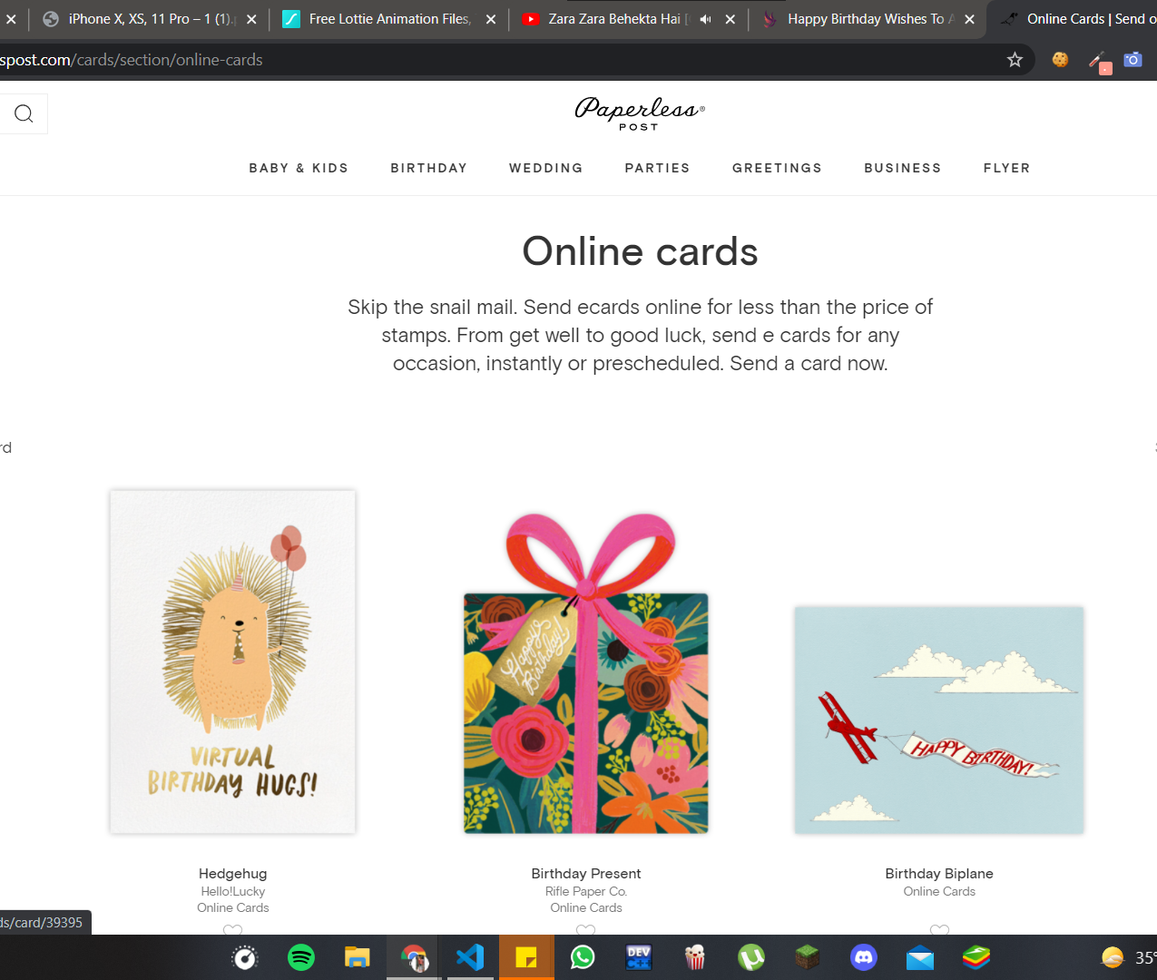

Slide 10
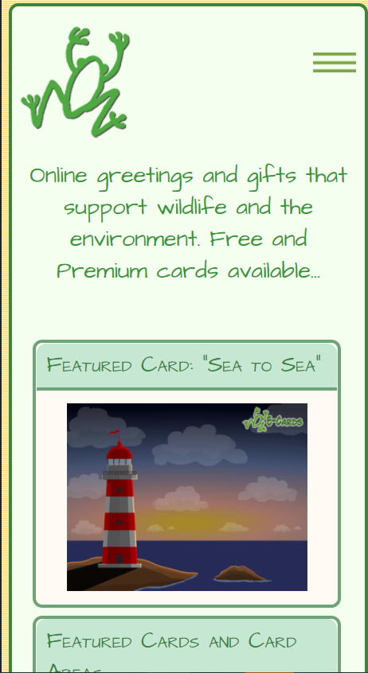
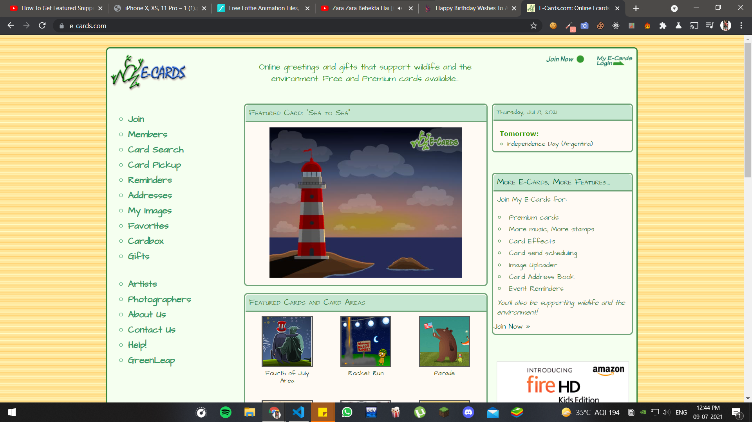

Slide 11
THANK YOU
By Puneet Dhiman
8377951023

